Slide 1
Climate Change and Malaria
Group 8:
Mary Kruse
Aparna Potdar
Neil Gandhi
Sharal Stanley

Slide 2
Temperature and Malaria
What is the relationship between the two?
What does the result suggest?
Notes:
We decided to investigate trend of one specific disease Malaria which is vulnerable to climate change and the trends against the climate change vulnerability
What does the result suggest? How can countries/states/cities allocate resources to be better prepared for climate change related health issues? Can we suggest changes in public policy, livability of areas more dramatically affected by climate change?

Slide 3
Sources
Malaria Risk- http://apps.who.int/nha/database/Select/Indicators/en (Global Health Observatory- Population at Risk of Malaria)
Population by Country and Year- https://en.wikipedia.org/wiki/List_of_countries_by_past_and_future_population
Temperature by Country and Year-https://www.kaggle.com/berkeleyearth/climate-change-earth-surface-temperature-data
Climate Change Vulnerability- https://gain.nd.edu/our-work/country-index/download-data/

Slide 4
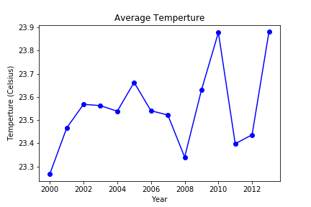
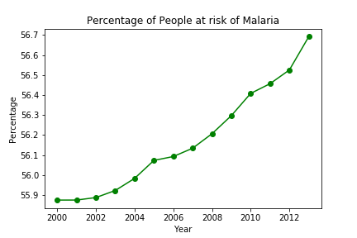
Overall Relationship between
Global Temp and Malaria Risk

Slide 5
Global Correlation?
.47
A small but notable positive relationship
Notes:
Small but positive linear relationship

Slide 6
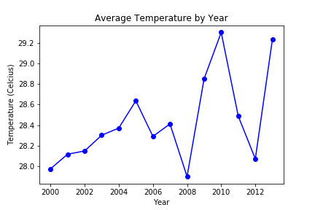
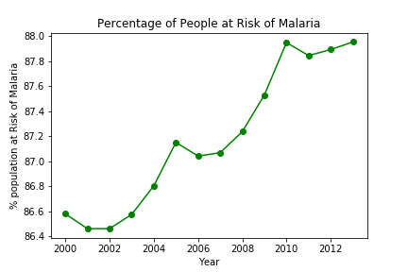
Niger - Temperature change vs. Malaria Risk as percent of population [Correlation = .62]

Slide 7
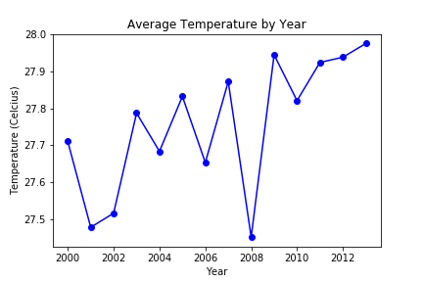
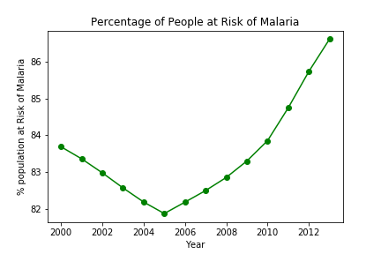
Somalia - Temperature change vs. Malaria Risk as Percent of Population [Correlation = .49]

Slide 8
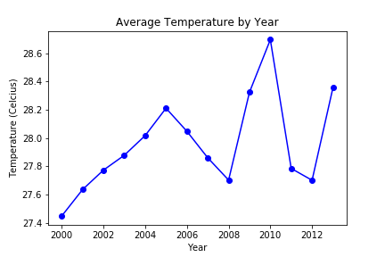
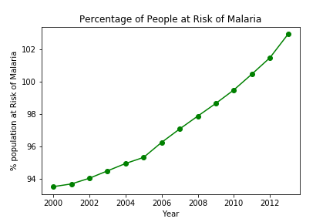
Chad - Temperature change vs. Malaria Risk as percent of population [Correlation = .43]

Slide 9
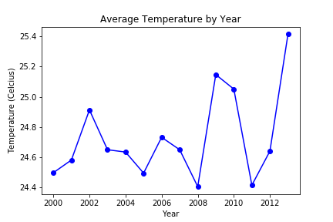
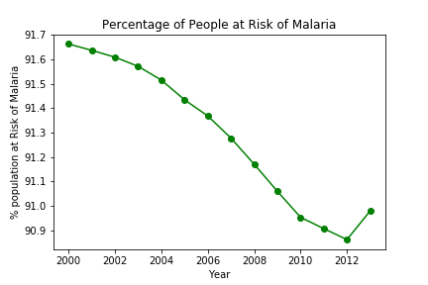
India - Temperature change vs. Malaria Risk as percent of population [Correlation = -.33]

Slide 10
Conclusion
There is a small positive correlation between temperature increases and malaria risk.
This correlation may be stronger for countries which are generally recognized as being vulnerable to climate change, but more research is needed.

Slide 11
Questions?

